Slide 1
Recommendation ITU-R BT.656 and BT.1120
Yucheng_Xiang
2024-9-10

Slide 2
Background Information

Slide 3
BT Series
Broadcasting service (television), digital video protocols for streaming television signals between digital equipment
Developed by International Telecommunication Union (ITU)
 | Resolution | Video Format | Digital Interface
SDTV | 720*480i(NTSC), 720*576i(PAL) | BT.601 | BT.656
HDTV | 1080p, 1080i | BT.709, BT.2100^{[1]} | BT.1120
UHDTV | 3840*2160, 7680*4320 | BT.2020, BT.2100 | BT.2077
[1]: HDR (high dynamic range) TV

Slide 4
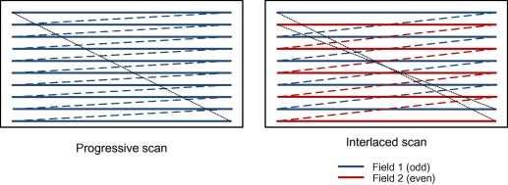
Interlaced Scan
Use two fields to create a frame. One field contains all odd-numbered lines in the image; the other contains all even-numbered lines
double the perceived frame rate and save bandwidth
Interlaced scan vs progressive scan

Slide 5
BT.601-7
Studio encoding parameters of digital television for standard 4:3 and wide-screen 16:9 aspect ratios
The form of YCbCr was defined for SDTV (standard-definition television) in the ITU-R BT.601 standard.
Two format: YCbCr 4:2:2, YCbCr 4:4:4
Limited range (8-bit Y[16, 235], CbCr[16, 240])
Translation between BT.601 limited range YCbCr
and sRGB colorspaces

Slide 6
ITU-R BT.656

Slide 7
BT.656-5
Interface for digital component video signals in 525-line and 625-line television systems operating at the 4:2:2 level of Recommendation ITU-R BT.601.
Define the parallel^{[1]} and serial interfaces for transmitting 4:2:2 YCbCr digital video.
Use unique timing codes embedded in the video stream instead of conventional video timing signals (HSYNC, VSYNC).
Active video resolution is 720*480i (525 lines NTSC 30fps) or 720*576i (625 lines PAL 25fps).
Other active resolutions and progressive scan can be supported by adjusting EAV and SAV codes and vertical blanking intervals occur.
Signals coded in 8-bit or 10-bit. When 8-bit video data are used, two LSBs of zeros are to be appended to the 8-bit words to form 10-bit words.
[1]: parallel interface is deprecated in latest BT.656 recommendation but still use widely in video ICs

Slide 8
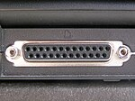
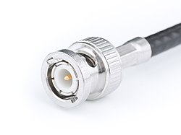
Serial vs parallel interface
Parallel interface:
1 clock line + 8/10 data lines
Coding: NRZ form
Pixel clock: 27MHz
Serial interface:
1 clk line + 1 data line
Coding: NRZI form, scrambled using G1(x)*G2(x), ${G1\left(x\right)=x}^{9}+x^{4}+1$, $G2\left(x\right)=x+1$
Pixel clock: 270MHz
Transmission by coaxial or optical fibers
SD-SDI (Standard definition-Serial digital interface) First defined in SMPTE 259M
DB-25 connector
BNC connector

Slide 9
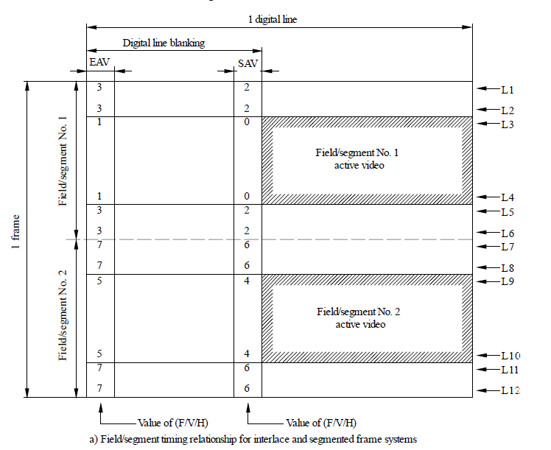
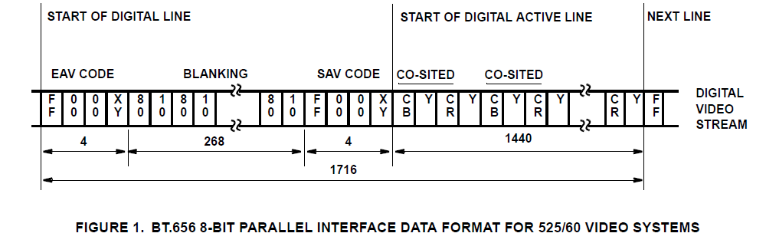
Video Stream Format
Each line consists of EAV(end of active video) + BLANKING + SAV(start of active video) + ACTIVE DATA

Slide 10
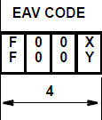
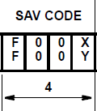
EAV and SAV
For compatibility with 8-bit interfaces, the values of bits D1 and D0 are not defined.
EAV and SAV consist of 4 bytes, first 3 bytes are fixed
F = 0 during field 1, 1 during field 2
V = 0 elsewhere, 1 during field blanking
H = 0 in SAV, 1 in EAV
P3~P0: protect bits, one-bit errors to be corrected and two-bit errors to be detected
P3=V⊕H
P2=F⊕H
P1=F⊕V
P0=F⊕V⊕H

Slide 11
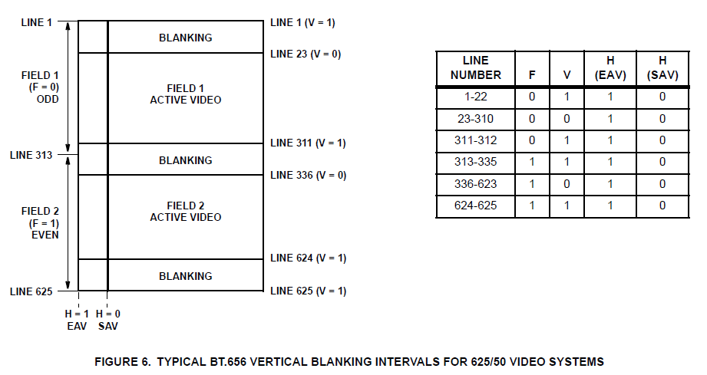
EAV and SAV
625-lines video system:

Slide 12
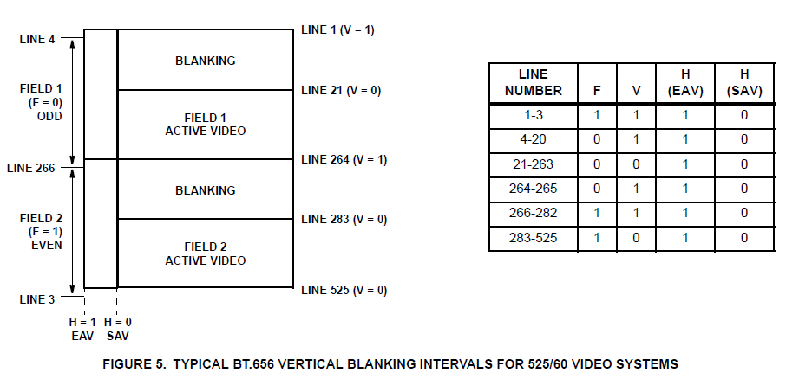
EAV and SAV
525-lines video system:

Slide 13
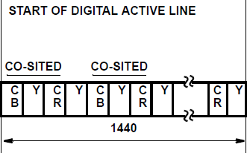
Active Video Data
Pixel format is 8-bit/10-bit 4:2:2 YCbCr.
27Mword/s
Bit2~9 all set to 1 or 0(0xff, 0x00) are reserved for data identification.
$Cb0Y0Cr0Y1Cb1Y2Cr1Y3…Cb359Y718Cr359Y719$
Each line generates 720 active samples, resulting in 720 samples of Y and 360 samples of Cb and Cr.

Slide 14
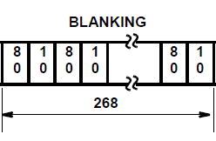
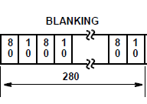
Blanking and Ancillary Data
Ancillary data like audio, subtitle, teletext can be inserted into blanking regions.
Refer to ITU-R BT.1364 for details.
If no ancillary data, blanking regions are composed by sequences $CbYCrY.$
8-bits: 0x80, 0x10, 0x80, 0x10…
10-bits: 0x200, 0x40, 0x200, 0x40…
Standard 525-lines system has 268 blanking and 625-lines system has 280 blanking.

Slide 15
ITU-R BT.1120

Slide 16
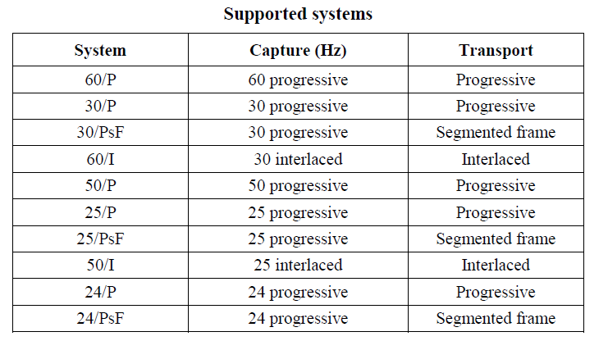
BT.1120-9
Digital interfaces for studio signals with 1 920 × 1 080 image formats
Signals coded in 8/10-bit word
YCbCr or RGB format defined in BT.709 and BT.2100
PsF: Progressive segmented Frame, sends a progressive video format as an interlaced video signal

Slide 17
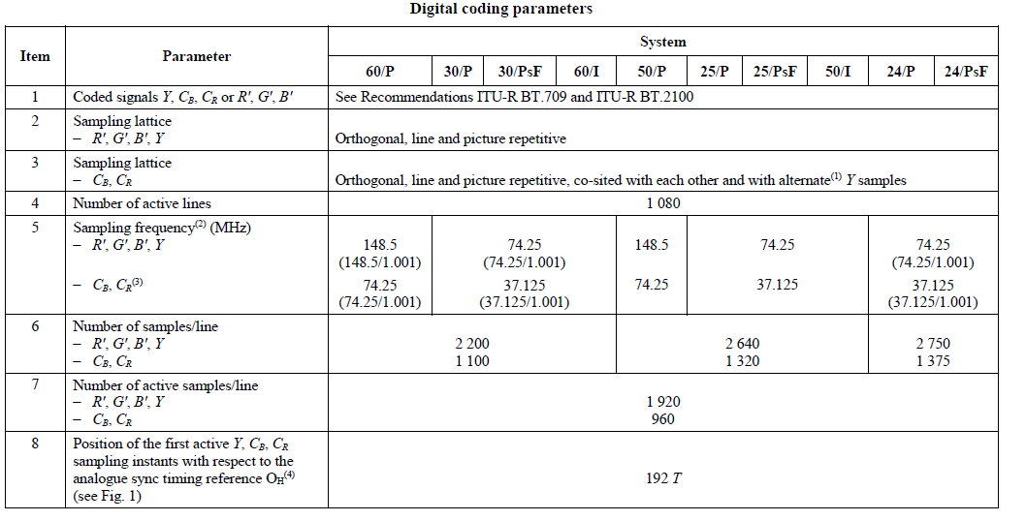
Digital coding parameters
Parallel interface pixel clock: 148.5MHz for 60/P, 50/P, 74.25MHz for other systems
148.5/1.001 MHz(59.94fps), 74.25/1.001 MHz(29.97fps) to yield a flicker-free image

Slide 18
Cont.

Slide 19
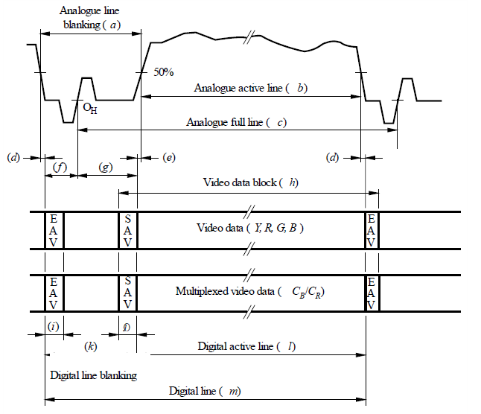
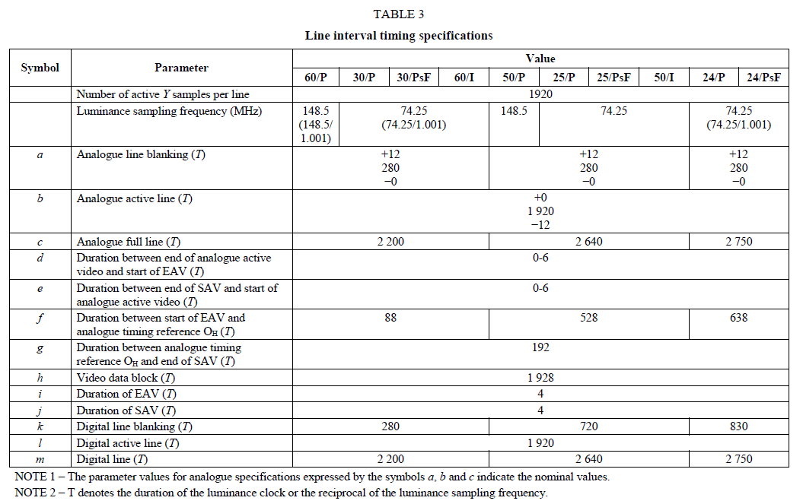
Video timing

Slide 20
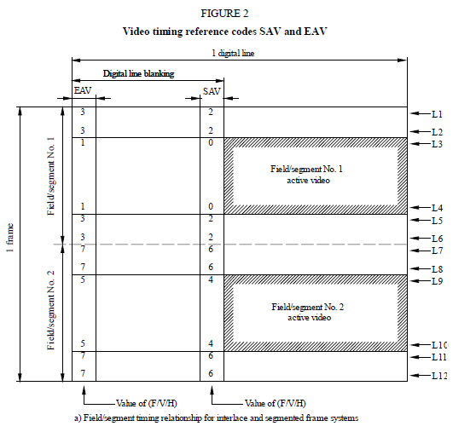
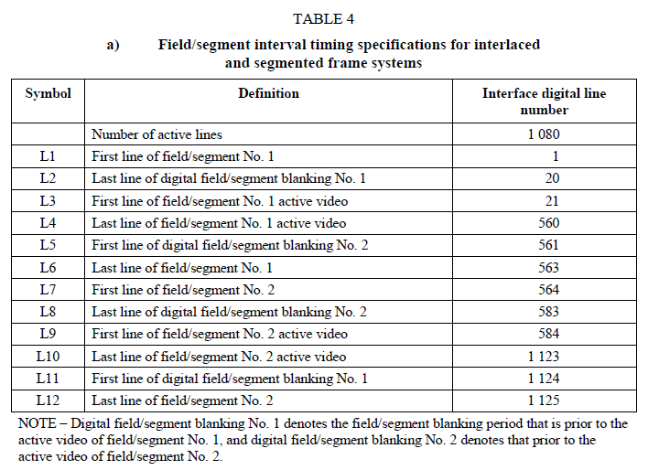
Cont.
Interlaced and segmented frame systems:

Slide 21
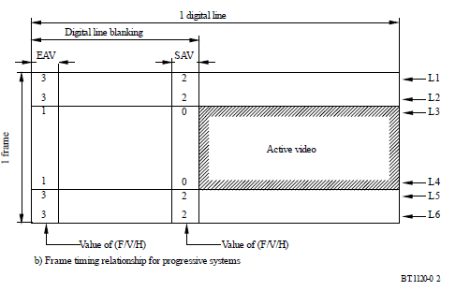
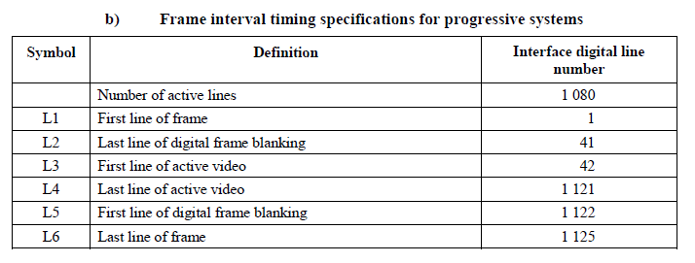
Cont.
Progressive system:

Slide 22
Parallel vs Serial interface
Parallel interface:
20/30 data lines in specification, found 16/24 data lines used in video ICs
10 lines for Y, 10 lines for Cb/Cr
Serial interface:
HD-SDI standardized by SMPTE 292M
Dual link HD-SDI standardized by SMPTE 372M
3G SDI standardized in SMPTE 424M
In serial interface, additional check words(LN line number and CRC) are provided to increase the robustness of the interface
In HD applications, serial data format is 20 bits wide, divided into two parallel 10-bit data streams(Y and CbCr). These data channels shall be multiplexed to form the serial data stream.

Slide 23
Reference
BT.656 recommendation:
Recommendation ITU-R BT.656-5 Interface for digital component video signals in 525-line and 625-line television systems operating at the 4:2:2 level of Recommendation ITU-R BT.601
AN9728.2 BT.656 Video Interface for ICs
https://techdocs.altium.com/display/FPGA/ITU-R+BT.656+Protocol
BT.1120 recommendation :
Digital interfaces for studio signals with 1920 × 1080 image formats
BT.656 encoder ICs: adv7180, TVP5150
BT.656 decoder ICs: adv7390, bt656_decoder
BT.656 panel driver ICs: ili9322
BT.1120 encoder&decoder ICs: RK628

